Slide 1
Natural Resources of Pakistan
Presented By Allahdad

Slide 2
A Little Information regarding Minerals and Mining in Pakistan :
Mining is an important industry in Pakistan. Pakistan has deposits of several minerals. The Pakistan Mineral Development Corporation is the responsible authority for the support and development of the mining industry.
Balochistan has the most mineral deposits among the provinces of Pakistan, with Sindh rich in coal deposit and Khyber Pakhtunkhwa rich in Oil, Gas and minerals used in Nuclear energy.
Currently around 52 minerals are mined and processed in Pakistan.

Slide 3
Some Important Natural Resources of Pakistan
Salt
Coal
Gold
Chromite
Iron
Copper
Oil
Gas

Slide 4
Salt
Pakistan has Huge Deposits of Salt Compare to other countries.
Pakistan Produces 350,000 million tones of Salt per year. Khewra Salt mine is world’s 2nd Biggest Salt mine, Alexander the Great’s Troops discovered this mine in 326 BC.
Himalayan salt is rock Salt mined from the Punjab region of Pakistan. The salt, which often has a pinkish tint due to trace minerals, is primarily used as a food additive to replace refined table salt but is also used for cooking and food presentation.

Slide 5
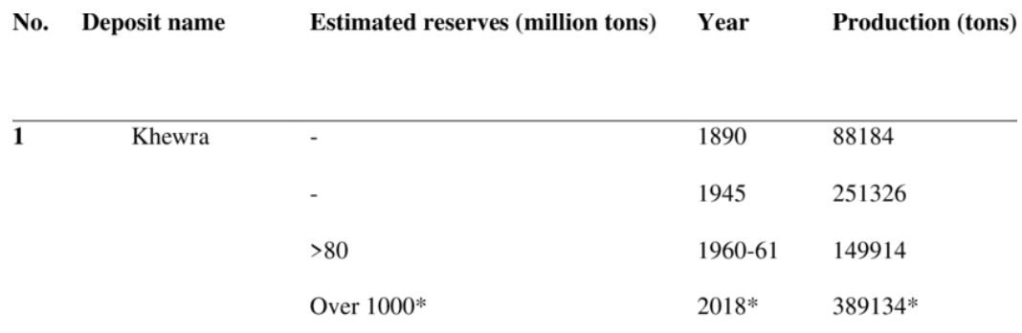
Khewra Salt Mine Production

Slide 6
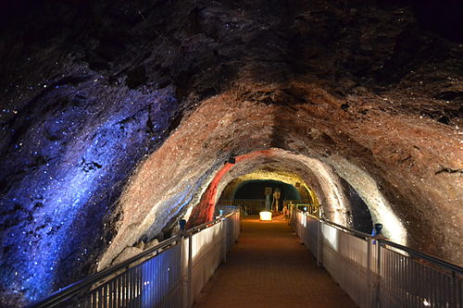
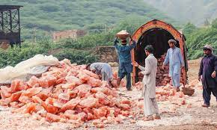
Khewra Salt Mine

Slide 7
Coal
Pakistan has Coal deposits in Sindh, Punjab and Balochistan.
Pakistan has reserves of Approximately 185 billion tones Coal. 185 BT of Coal costs around $30 trillion which can produce electricity for 500 years.
Thar has the Most Coal Deposits in Entire Pakistan, 16th most in the world.
24 Million tones of Coal is being used annually in Pakistan.
Pakistan stands at 20th position in world for Coal Reserves.

Slide 8
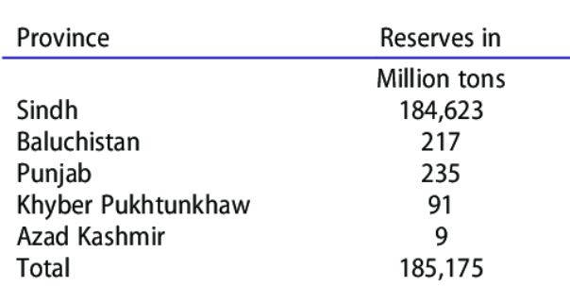
Coal Reserves in Pakistan

Slide 9
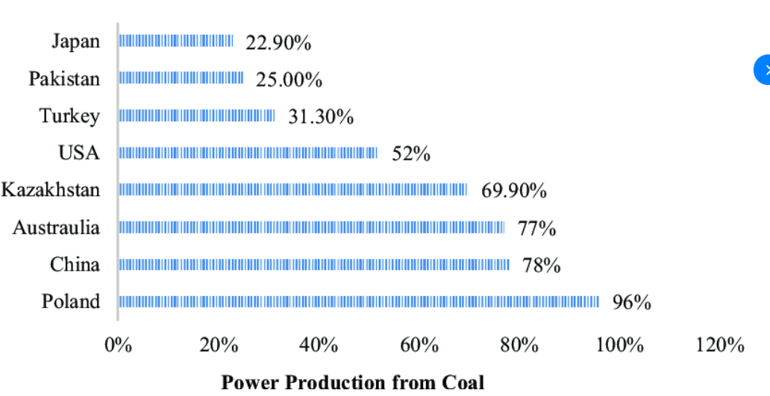
Power Production Data

Slide 10
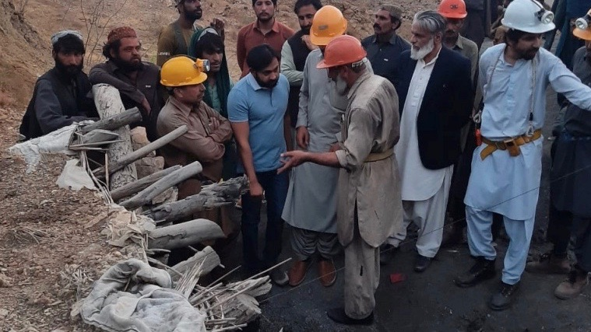
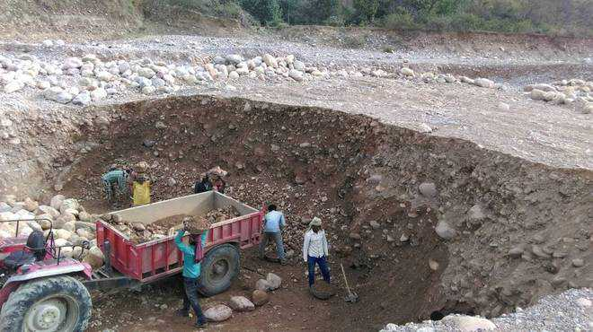
Thar Coal Mine

Slide 11
Gold
Pakistan is very rich in Natural Resources of Gold.
Gold is one of the Most Expensive Natural Resource in Pakistan and in the World.
Current Price Of Gold in Pakistan (24 Gram = 150,000)
There are estimated over 1600 million tons of Gold reserves in Pakistan. Reko Diq, Balochistan have the World’s 5th Largest Gold Deposits, It has 20.9 million tons of Gold deposits.

Slide 12
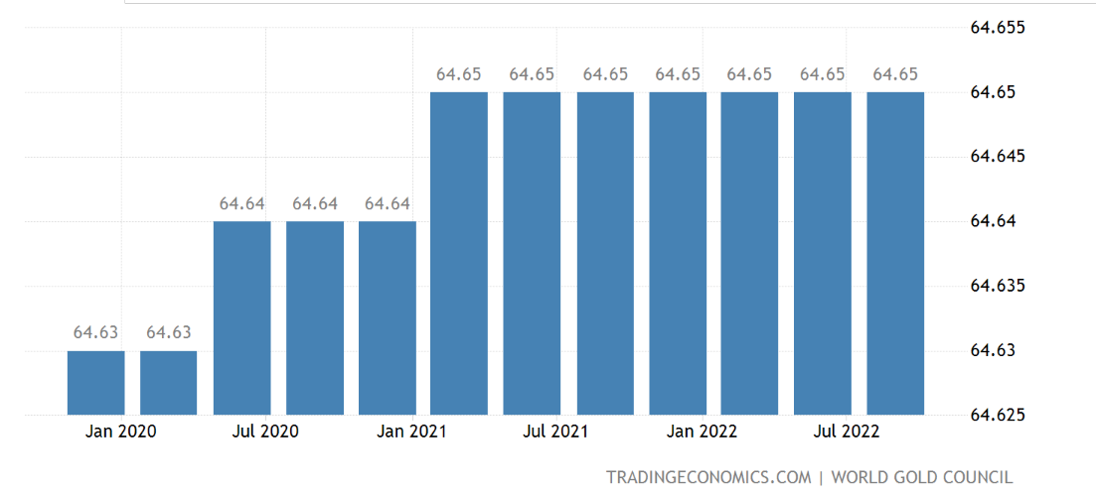
Gold Production 2020-2022

Slide 13
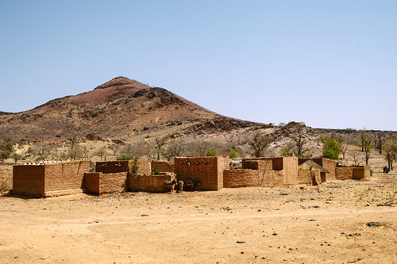
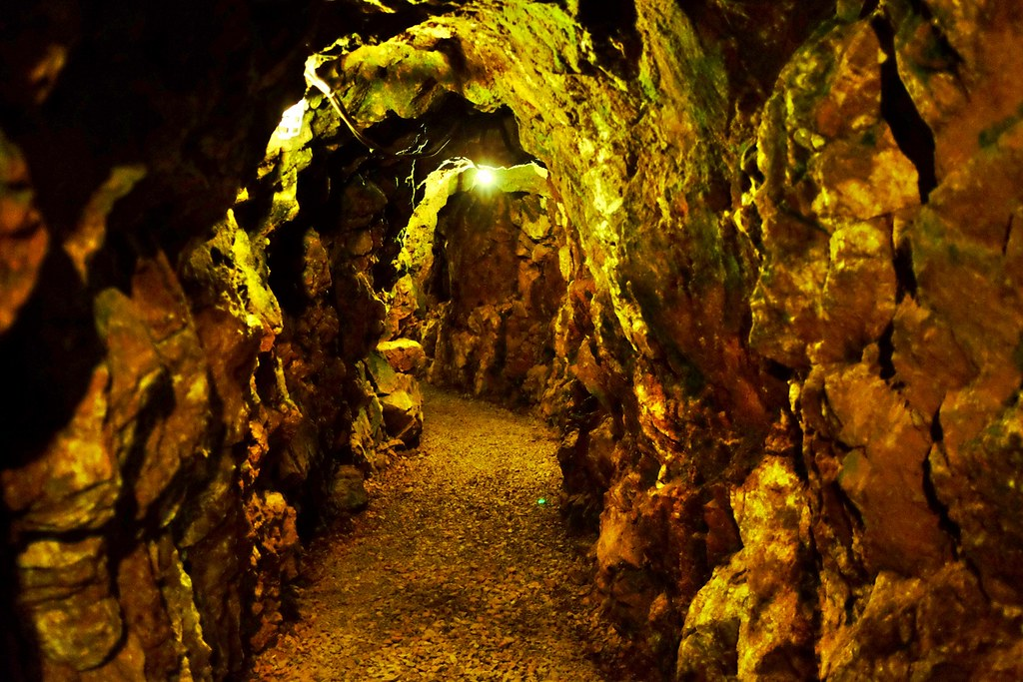
Reko Diq Gold Mine

Slide 14
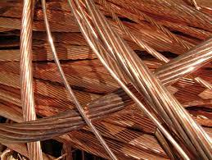
Copper
Copper is used for Power, Heating and Communication.
The Reko Diq mine is a planned mining operation, located near Reko Diq, Balochistan, Pakistan. Reko Diq represents one of the largest copper reserves in the world having estimated reserves of 5.9 billion tones of ore grading 0.41% copper.

Slide 15
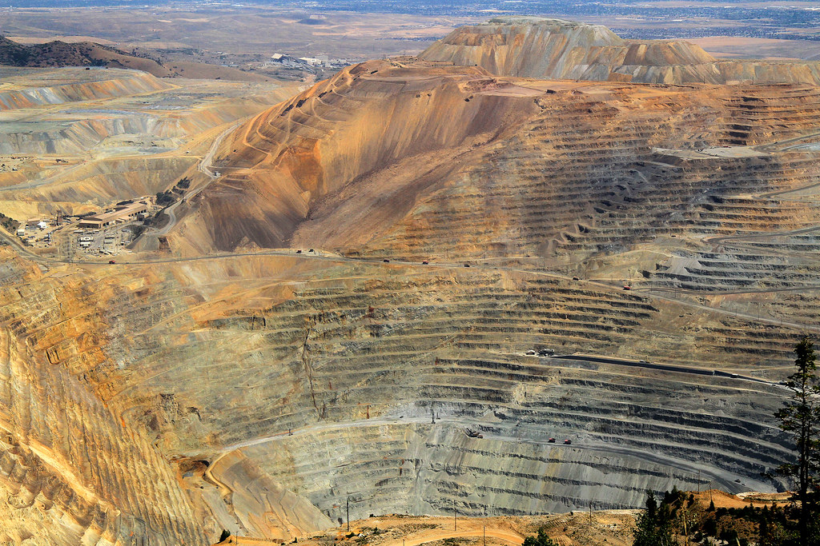
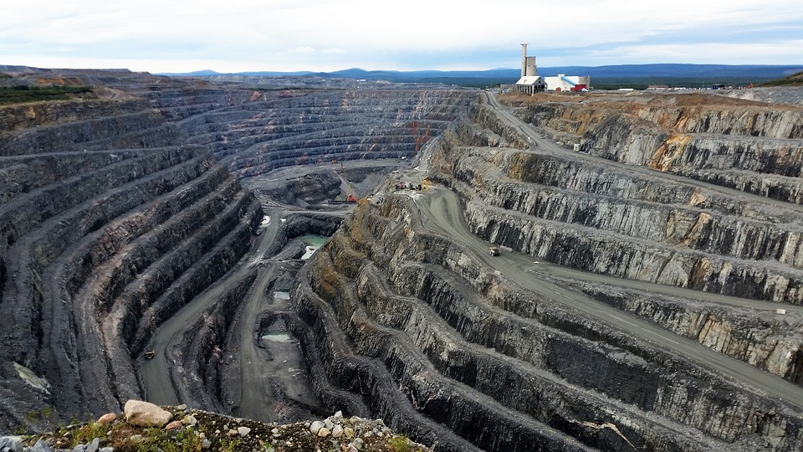
Reko Diq Copper Mine
This Photo by Unknown Author is licensed under CC BY-SA-NC

Slide 16
Gas
Sui, Balochistan is very famous for Producing Natural Gas. Sui was discovered in 1952 it was first Gas Field in Pakistan.
Pakistan holds 20.91 trillion cubic feet of proven Gas reserves as of 2020, ranking 29th in the world.
Annual Gas Production : 1,504,900 million cubic feet
Annual Gas Consumption : 1,480,300 million cubic feet
Annual Gas Imports : 50,456 million cubic feet
Pakistan has proven reserves equivalent to 12.0 times its annual consumption. This means it has about 12 years of Gas left (at current consumption levels and excluding unproven reserves).

Slide 17
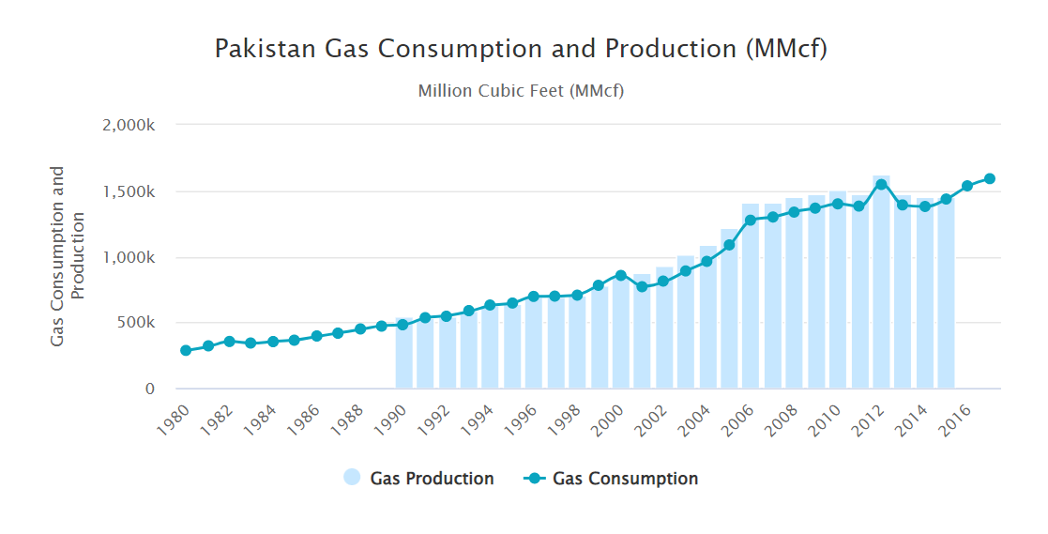

Slide 18
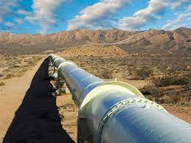
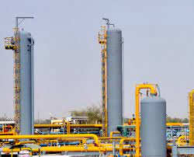
Sui Gas Field

Slide 19
Iron
Iron ore is found in various regions of Pakistan including Chiniot, Kalabagh (the largest one), Haripur and other northern areas.
In February 2015, reserves were found in Chiniot, by a Chinese group, the Metallurgical Cooperation of China. A senior provincial administrative official told that initial estimates indicated 500 million tons of Iron ore had been discovered.
According to estimates, Pakistan has around 1,497 million tons of low to high-quality Iron ore available.

Slide 20
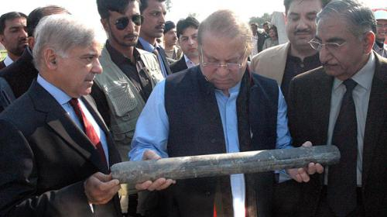
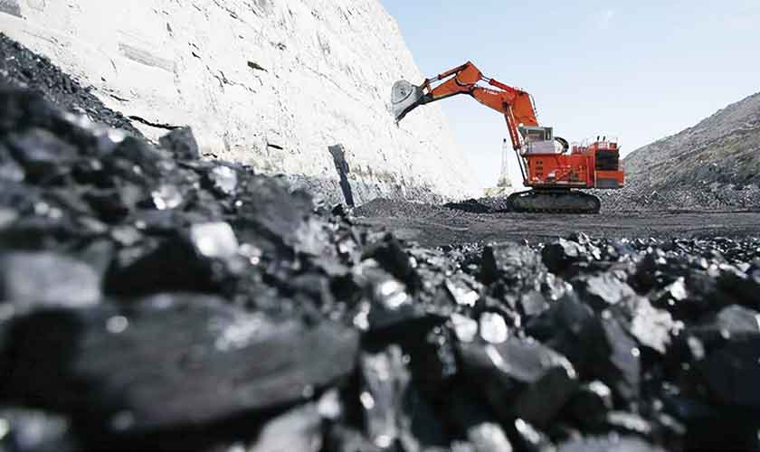
Chiniot Iron Field

Slide 21
Chromite
The chromium extracted from Chromite, is used as a pigment for glass, glazes, and paint, and it is used to induce hardness, toughness and chemical resistance in steel.
Chromite was first discovered in 1901 in the areas between Khanozai & Muslim Baghin Zhob valley, Balochistan, and mining started in 1903.
Pakistan Mineral Production: Chromite data was reported at 8,598.000 million Ton in Apr 2018.

Slide 22
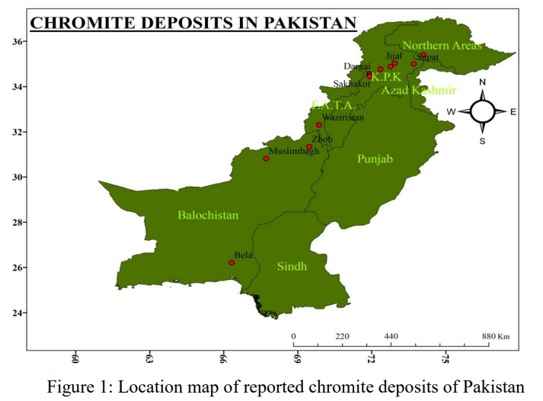

Slide 23
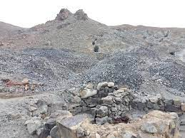
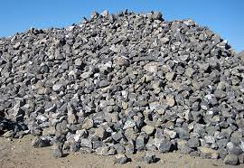
Chromite Field in Balouchistan

Slide 24
Oil
Pakistan holds 3.53 billion barrels of proven oil reserves as of 2019, ranking 52nd in the world and accounting for about 0.2% of the world's total oil reserves of 1,650,585,140,000 barrels. Pakistan has proven reserves equivalent to 1.7 times its annual consumption.
Pakistan's total refining capacity is approximately 4 Lac barrels per day or about 19 million ton per year of oil, however, they export 11.6 million tons per annum.
Punjab and Balouchistan has huge amount of Oil Deposits in Pakistan.
DHULLIAN oil-field is located about 10 miles north-west of Khaur, Attock (Punjab). Discovered in 1937, this is the biggest field in the country.

Slide 25
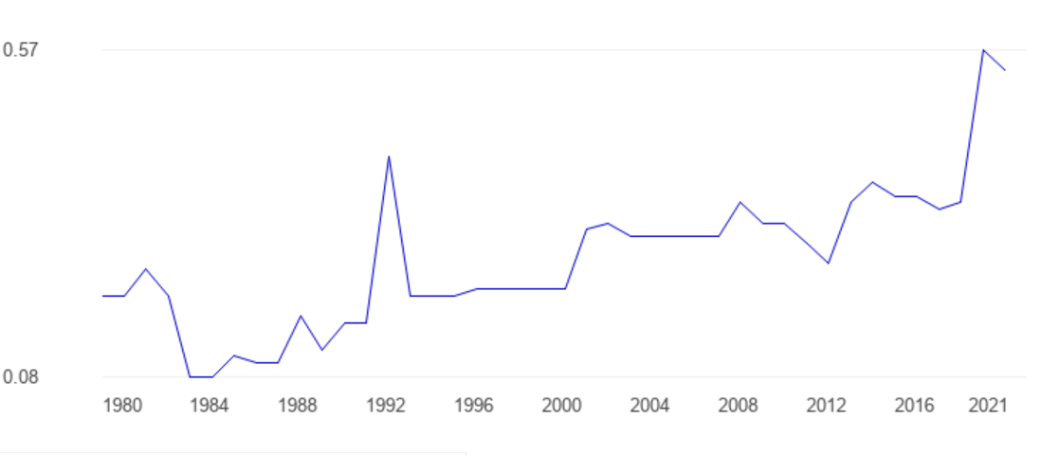
Oil Production Data 1980-2021

Slide 26
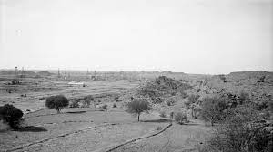
Khaur Oil Field

Slide 27
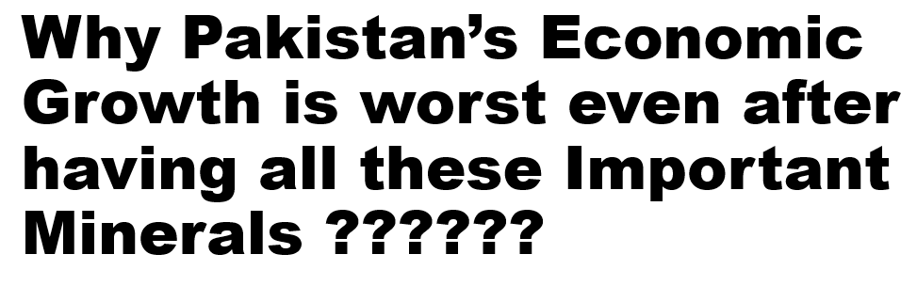


Slide 28
One of the Mainstays of any country around the world for Economic Development is its existing Natural Resources and Assets.
Despite being Blessed with Fertile Agriculture Lands, Natural Minerals and Industrial Bases Pakistan Economic Development is not Progressing as it should.

Slide 29
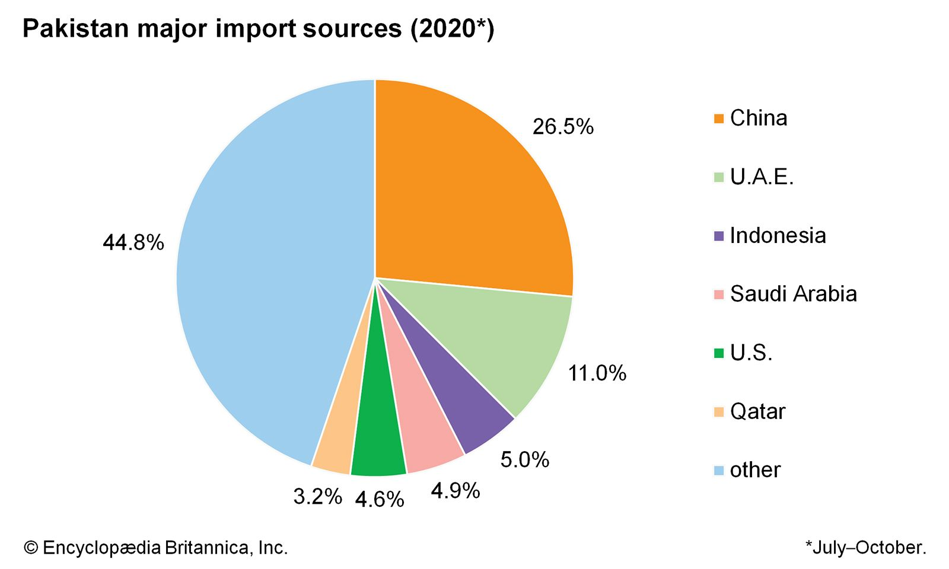
Pakistan Import Sources

Slide 30
Here are some reasons behind Struggling Pakistan’s Economy
Energy Crisis
Terrorism
Corruption
Youth Unemployment
Poor Health Facilities
Huge Debt
Over Population
Lack of Good Governance
Wealth Concertation

Slide 31
Reasons of Energy Crisis
Over Consumption
Over Population
Poor Infrastructure
Wastage of Energy
Poor Distribution System

Slide 32
Terrorism
It is a huge set back for economic generation in Pakistan. Since 2002 we are a war-torn country. The State Bank of Pakistan report (2016) says that war on terrorism has cost $118 billion. According to Global Terrorism Index (2016), out of 163 countries, Pakistan stands 4th worst hit. This has long been a reason for Pakistan’s negative international image which has limited the foreign investment in the country.

Slide 33
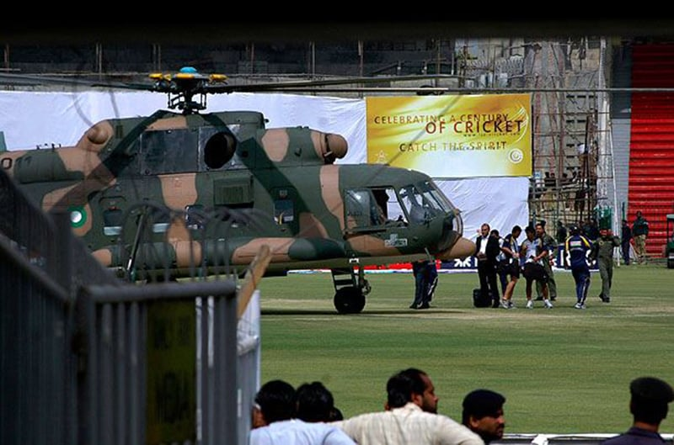
Terrorist Attack on Srilankan Cricket Team in Lahore in 2009

Slide 34
Corruption
Corruption in Pakistan is widespread, and extends to every sector from government to judiciary, police, health services and education. The problems are long-standing, and despite ongoing calls for reform, and many attempts to improve the situation, there is little evidence of progress.
According to corruption perception index (CPI 2019) out of 175 countries Pakistan stands at 116.

Slide 35
Wealth Concertation
In Pakistan wealth is concentered among a few rich families. The rest of the population is dependent on them. Due to wealth concentration, around 35 percent people spend their lives under poverty line. According to Multidimensional Poverty Index (2016) 39 percent population of Pakistan lives in poverty, which means that 4 out of 10 people in Pakistan live in poverty

Slide 36
Youth Unemployment
We are blessed in having about 63 percent of youth population. Half of them are unemployed. According to Asian Development Bank (ADB) 50.7 percent of the population aged 15 years and above is employed. Of it, the female ratio is very less. The rest are struggling for survival. On an average, Pakistan needs to create 20 million job annually for young people alone.

Slide 37
Poor Health Facilities
The public hospitals depict bleak pictures where we find lack of proper medicines, beds, equipment and etc. Due to absence of basic health facilities, 170 women die from pregnancy for every 100,000 births. For every 1,000 babies born, 66 die before their first birthday. In addition, approximately 44 percent children in Pakistan are stunted. Every day, due to malnutrition and poverty children are dying in Thar.

Slide 38
Huge Debt
Statistics released by the central bank, show that Pakistan's total debt and liabilities peaked, by an unsustainable 24%, to Rs 62.5 trillion at the end of September 2022 – pushing the country into unchartered territ

Slide 39
Over Population
When the facilities and food of a country are not enough for its people are called overpopulation. Overpopulation leads to food insecurity and also environmental problems. In Pakistan 60 percent of Pakistanis already live with food insecurity. The main causes of overpopulation are, The influx of refugees from Afghanistan, has resulted in an increase in population. Another cause of overpopulation is a decrease in the death rate. In 1951, the death rate was 2.8 percent, but in 2010-11, it was only 0.73 percent. However, Pakistan is among the most overpopulated countries in the world, and it remains the fifth most populous country in the world. The population of Pakistan is 224,770,387 according to the census of May 2021.

Slide 40
Lack of Good Governance
Government should improve relations with neighbouring countries like India, Iran, and Afghanistan.
For economic information, communication and technology sectors among others should be given more preference and government should improve ICTs system. Because in forthcoming years, all the economies will be measured through technologies. India earns lots of money through its IT industry.
The employment zones for youth should be opened so as two-third of youth could contribute for the economy of Pakistan. They could use their potentials and skills for better Pakistan

Slide 41


